Slide 1
AL305-Physics II
Meeting #2
Photon Beam Dosimetry
John M. Kratina, BMEd, RT(R)(T) LRT - Instructor
Copyright 2009 John M. Kratina

Slide 2
Calibrated Isocenter Distance
All Linac’s are Calibrated to a Defined—Isocenter Distance. This distance comes into play when making Tx calc’s.
Older Tx Machines, Co60, 4MV and 6MV are calibrated at an *Isocenter Distance of 80 cm.*
Newer Tx Machines have a Calibrated Isocenter Distance of 100 cm.

Slide 3
Calibrated Isocenter Distance
See Stanton page 338-Appendix 5: View that the calibrated Isocenter Distance for 4MV is 80cm.
See Stanton page 340: View that the Newer 10x (or MV) Linac’s have an Isocenter Calibration of 100cm.
The Isocenter Calibration will effect how we do Tx calculations.

Slide 4
Maximum Dose: Dmax
The maximum dose (Dmax) occurs at the point at which the energy of the electrons coming to rest equals the E of electrons being set into motion by new photon interactions. This point at which equal numbers of electrons are being stopped and driven forward or where Kerma equals Dose is called Electron Equilibrium.
*Other Equivalent Terms include: Incident Dose, Given Dose, Dose to Dmax and Dose to Dmax Zone of Intensity all refer to the same thing: *DMAX.*

Slide 5
Dmax Dose
Dose at maximum Depth , for a single field treatment with a megavoltage beam, is the point where the highest dose occurs. In a single field tx, the Tumor Dose is less the the Dmax Dose.
The depth of Dmax increases with Beam E.
*Remember, Depth of Dmax increases as Beam Energy Increases.*

Slide 6
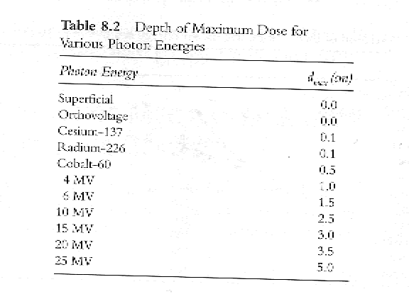
Dmax Dose

Slide 7
Dmax
So, the Depth of Dmax of a 15MeV Beam is Greater than a 6MeV Beam.
Skin sparing effects increases (on the entry side of the Beam) as the Beam Energy (E.) increases.
Thus, a 10 MEV beam has more , beam entry side, skin sparing effects than a 4MeV Beam. View page 100, Table 8.2 to see this. See how the Depth of Dmax for a 4Mev Beam is 1.0 cm while the Depth of Dmax for a 10 Mev beam is 2.5cm? Please memorize this chart.

Slide 8
Exit dose
High E. beams always have an Exit dose.
We know that as Beam E. increases, the dose to the skin, on the entry side of the beam, decreases. Thus the skin sparing effect increases. ^E. = ^skin sparing.
Now, as the Beam E. increases, the Exit Dose increases.
See page 338, table 2 and page 341, table 5.
Remember: * As the Beam E. increases, skin sparing increases on the beam entry side =and= the Exit Dose increases on the Beam Exit side.*

Slide 9
Scatter
The radiation treatment beam is composed of both primary and scatter radiation.
Any interaction of the primary beam may result in scatter.Radiation that is scattered back towards the surface of the patient is called Backscatter.

Slide 10
Scatter
THE PHOTON BEAM CONSISTS OF 1- PRIMARY BEAM AND 2- SCATTER COMPONENT
THE SCATTER PART HAS SEVERAL FACTORS TO CONSIDER: FIELD SIZE (FS), FD SHAPE, BEAM
E., AND FIELD BLOCKING.
SCATTER PLAYS A ROLE IN PERCENTAGE DEPTH DOSE
(PDD) AS WELL AS TMR.
PLEASE NOTE: FOR A GIVEN DEPTH, AS FD SIZE
INCREASES, THE VALUE OF PDD(%DD) OR TMR INCREASES.---THIS IS BECAUSE OF SCATTER.

Slide 11
Back Scatter Factor
BSF= Dose at dmax in phantom
---------------------------
Dose without backscatter
The ratio of the dose at a point in dmax including backscatter to the dose at the same point in air without backscatter.
This is also known as peak scatter factor.

Slide 12
BSF
Backscatter is Dependent on
Beam Energy
Scatter
Beam Geometry

Slide 13
BSF
BSF INCREASES AS E. INCREASES UP *UNTIL* 62
KEV. THEN COMPTN SCATTER TAKES OVER.
AT 2MEV, SCATTER IS VIRTUALLY FORWARD SCATTER.
*SEE STANTON PAGE 177, FIG 12.3
AT HIGH E., THE BSF IS ALSO CALLED THE PEAK
SCATTER FACTOR AND IT'S VALUE APPROACHES "AROUND 1.0"

Slide 14
MU/Time Calculation Factors
Cfs =field size correction factor –or- output factor for field sizes other than 10X10cm.
Ccal =machine calibration output or dose rate, usually 1.00cGy/MU for LinAc’s @ 10 X 10 f.s.
Cattn = transmission factor for block trays and /or wedges.

Slide 15
Output Factor –or- Cfs
OUTPUT FACTOR, STANTON PAGE 178
REMEMBER: OUTPUT FACTOR = Cfs
THE STANDARD CFS OR OUTPUT FACTOR IS "1" AT 10 X 10 CM FS AT DMAX DEPTH.

Slide 16
Output Factor –or- Cfs
YOU WILL WANT TO REMEMBER THAT THE *OUTPUT FACTOR IS LESS THAN "1" AT A F.S. **LESS***THAN 10 X 10.
THUS, A CFS OR OUTPUT FACTOR IS GREATER THAN "1" WHEN THE F.S. IS GREATER THAN 10 X 10
NOTE THAT GREATER THE FS, THE GREATER THE
OUTPUT DUE TO INCREASED BACKSCATTER TO DMAX FROM PHANTOM OR PATIENT -AND- FORWARD SCATTER OF THE JAWS CHANGES BACKSCATTER TO THE MONITOR CHAMBER.****THIS IS ALL VERY IMPORTANT TO CONSIDER****

Slide 17
Output factor = Cfs
SO, REMEMBER THAT Cfs=FIELD SIZE CORRECTION FACTOR = *OUTPUT FACTOR*
CFS = DOSE @ DMAX FOR A F.S. / DOSE @ DMAX FOR A STANDARD *10 X 10 cm* F.S.
CFS FOR 10 X10 CM = 1.0

Slide 18
Cfs or Output factor Calc
SEE PAGE 179
(Please Note: that there is a Typo on Stanton page 179. The Cfs and Ccal values are
incorrectly reversed.)
***HERE IS THE CORRECT CALCULATION:***
SEE THE CALCS HERE TO FIND OUTPUT AT 160 SSD
SO, OUTPUT 160 SSD = OUTPUT @ 80 SSD X INVERSE SQUARE FACTOR

Slide 19
Output calc
OUTPUT 160 SSD = OUTPUT @ 80 SSD X INVERSE
SQUARE FACTOR (this time, please note Dmax =1cm as stated.)
= OUTPUT @ 80SSD X (80 +1 /160+1)*2
=Cfs X Ccal X (81/161)*2
=1.00 (the correct Cfs) x 1.03 cGy/mu (the correct Ccal) x
(0.05031055)*2
=1.00 x 1.03 x 0.2531151
=0.2607085 cGy/mu
=0.261 cGy/mu (rounded up.)

Slide 20
Output Calc
Please note that we are to use the Standard,
10 x 10 F.S. unless otherwise stated.
We will be given the Ccal and Cfs in all equations on the Exam.

Slide 21
Problem #1, Stanton text,page198
Remember we have a Dmax of 1.5cm
We will use the Standard 10 x 10 F.S. so our Cfs =1.
We have been given the Ccal of 1.0 cGy/mu.
Plug this in your calculator…

Slide 22
Problem #1, Stanton text,page 198
Cfs x Ccal x (101.5/201.5)*2
= 1 x 1 x 0.254
= 0.254 cGy/MU
What was your answer on your calculator?

Slide 23
Equivlent Square Fields
In order to use the “square field” data tables, we must convert non-square fields to Equivalent Sqaure Fields.
ESF= 4 X Area/Perimeter
So, ESF = 4 x L x W / 2(L + W)
ESF will have the same Cfs, scatter effects and depth dose of a rectangular field.

Slide 24
ESF = 4 x A/P
See Stanton, page 179-180. THE ABOVE FORMULA CAN BE USED WHEN A CHART IS NOT AVAILABLE. Page 180 shows a computer generated field that is more accurate.
TURN TO QUESTION 8 IN THE STANTON CHAPTER 12 PROBLEMS ON PAGE 198.
First, we need the ESF FOR A 25CM X 10CM FD
ESF= 4 X A/P
ESF = 4 X L x W / 2(L + W)
=4 X 25X10 / 2(25+10) =
=4 X 250/70
=4 X 3.57
=14.285714
=14.3 ESF (rounded up.) (please note we got 14.3 ESF, while the computer chart shows 13.6)

Slide 25
Cattn factor
NEXT, WE HAVE EQUIP. ATTEN FACTORS OF BLOCKS AND TRAYS TO TAKE IN ACCOUNT.
THIS IS WHERE Cattn comes in.
Cattn = DOSE With DEVICE IN BEAM / DOSE Without DEVICE IN RAD BEAM
PLEASE SEE TABLE 12.3 IN STANTON PAGE 181. HERE WE CAN ALSO SEE FOR THE E.'S
WE ARE WORKING WITH, THE Cattn IS "USUALLY ABOUT 1"

Slide 26
Patient Attenuation Factors
Percent Depth Dose
Tissue-Air Ratio
Tissue-Maximum Ratio

Slide 27
PDD
PERCENT DEPTH DOSE IS USED *ONLY* FOR SSD OR NON-ISOCENTRIC CALCS.
PDD = ABSORBED DOSE @ DEPTH
----------------------------
ABSORBED DOSE @ DMAX X 100%
PDD IS DEPENDENT ON THE CALIBRATED ISOCENTER DISTANCE OF THE MACHINE.

Slide 28
PDD
PDD IS DEPENDENT ON THE MACHINE ISOCENTER DISTANCE OF THE MACHINE.
PDD WILL BE LESS FOR A GIVEN F.S. AND DEPTH FOR AN 80 CM ISOCENTER DISTANCE MACHINE VERSES A 100CM ISOCENTER DISTANCE MACHINE.
(FOR A VISUAL SEE PAGE PAGE 499 IN THE WASHINGTON TEXTBOOK. )
PDD Increases as E. increases.
PDD increases AS FS INCREASES, BECAUSE OF SCATTER.
PDD DECREASES AS DEPTH IN TISSUE INCREASES.

Slide 29
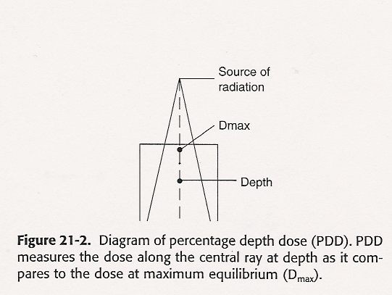
PDD- SEE PAGE 499 IN THE WASHINGTON TEXTBOOK

Slide 30
TAR
TAR IS ONLY FOR SAD OR ISOCENTRIC SET-UPS FOR 4MV OR COBALT 60 UNITS.
TAR
= DOSE @ GIVEN DEPTH IN PHANTOM @SAD
-----------------------------------
DOSE Without PHANTOM @SAD.
TAR VISUAL IS FOUND ON PAGE 500 OF WASHINGTON.

Slide 31
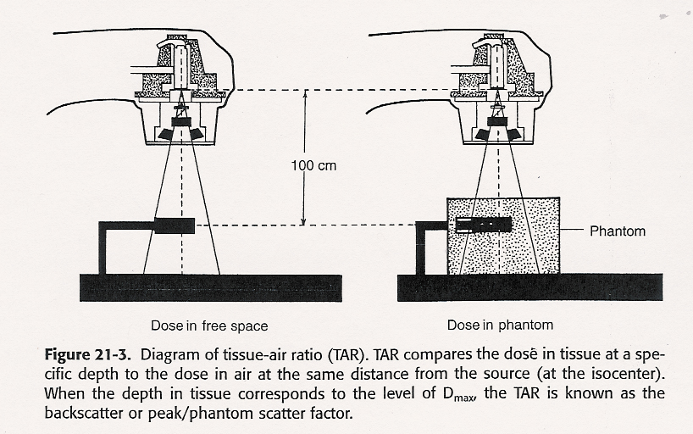
TAR VISUAL IS FOUND ON PAGE 500 OF WASHINGTON.

Slide 32
TMR
TMR IS USED FOR 6MV OR HIGHER E. SAD MACHINES.
TMR= DOSE @ DEPTH d
-------------------
DOSE @ DMAX
SEE PAGE 501 IN WASHINGTON FOR A TMR VISUAL.
PLEASE REMEMBER BOTH TAR AND TMR ARE *INDEPENDENT* OF THE MACHINE ISOCENTER DISTANCE.

Slide 33
TMR VISUAL - PAGE 501 IN WASHINGTON.

Slide 34
MU/Time Calculation Factors
Patient Attenuation Factors:
For Non-isocentric set-ups: %DD
For Isocentric set-ups: TAR or TMR
Tumor Dose = Dose precribed per field.
Nmu = number of monitor units.

Slide 35
NMU calcs. Here we go!
SEE WRITTEN ASSIGNMENT KEY -PHOTON BEAM Dosimetry MU PROB 1
AS FOUND IN BUONO WKBK PAGE 57.
WE ARE IN THE MIDDLE OF THE PAGE OF THE WRITTEN ASSIGNMENT KEY LOOKING AT
MU CALCS PROBLEM 1. (ON BUONO PAGE 55 WE LOCATED THE OUTPUT FACTOR OF
0.930)
THE PDD IS FOUND ON BUONO WKBK PAGE 54:

Slide 36
Using Sp (or PSF) and Sc (or COF) factors for MU Calcs with TMR
Some treatment centers use more than one output factor. Here we see the usage of:
Sp (or PSF) and Sc (or COF.)
Sp (or PSF) = phantom scatter factor
Sp (or PSF) is used to determine the scatter from the patient or phantom device.
Sc (or COF) = collimator output factor
Sc (or COF) is used to measure scatter from the coll.
An Inverse Square Correction Factor (ISCF or “SAD factor”) is used. (usually around “1” when the Machine Calibration Distance is the same as the SAD or the Isocenter )
Reference: Washington and Leaver, 3rd Ed. p. 497, 510-511. (2nd Ed.,p.475, 490-1)

Slide 37
Using Sp and Sc factors for MU Calcs with TMR
For an unblocked single field:
NMU=
Rx Dose
-------------------------------- x ISCF
RDR x Sc x Sp x TMR (or output) (CS) (EFS) (EFS)
(Reference: Washington/Leaver, 3rd Ed., p.511-512)

Slide 38
Using Sp and Sc factors for MU Calcs with TMR
A Radiation Oncologist wants a patient treated with a single open field, using a 6MV LinAc Isocentric (SAD) set-up at 100cm SAD.
The set-up SSD is 95cm. (that tells that we have a Tx depth of 5cm)
FS=15 x15cm open field
No block
No Tray
Inverse Square Correction Factor (since the machine calibration distance is at SAD) = 1

Slide 39
Using Sp (or PSF) and Sc (or COF) factors for MU Calcs with TMR
RDR (or Dose Rate or Output) = 1.0cGy/MU
Sc Factor (or Collimator Scatter Output Factor or COF)(for a 15 x 15 cm field) = 1.021(Washington, p. 517)
Sp Factor (or Phantom Scatter Factor or PSF)
(for a 15 x15 cm field) = 1.014 (Washington, p. 517)
TMR(depth of 5cm,15x15f.s.)=0.937 (Washington, Table 24-9, p. 523)
Dose per fraction = 310 cGy.
The Inverse Square Correction Factor (ISCF or SAD factor) since the machine calibration distance is at SAD) = 1
What is the MU setting using TMR?

Slide 40
Using Sc and Sp factors for MU Calcs with TMR
NMU=
310cGy
------------------------------ X 1.0
1.0cGy/MU X 1.021 x 1.014 x 0.937
(dose rate) (Sc) (Sp) (TMR) (ISCF)
NMU= 319.55 or 320 MU

Slide 41
Using Sp and Sc factors for MU Calcs with TMR
For blocked field:
NMU=
Rx Dose
--------------------------------- X ISCF
Outpt x Sc(openFS) x Sp(blkFS) xTMRxTF

Slide 42
Using Sp and Sc factors for MU Calcs with TMR
A Radiation Oncologist wants to treat a patient with POP AP and PA fields with a dose of 4000cGy at a depth of 10cm in 20 fractions. The physician wants to use a 6MV LinAC isocentric (SAD) delivery at 100cm SAD. The tx set-up SSD is at 90cm. FS= 15 X15. Thus, the Sc Factor (or COF) is 1.021. The fields are blocked to an 8 X 8 equivalent square field. Thus, the Sp Factor (or PSF) is 0.992.
What is the MU/fraction needed, using TMR?

Slide 43
Factors needed include:
Sc (or COF) for a 15 X 15 field size) = 1.021 (Washington, Table 24-9, p. 517)
Sp (or PSF) for a 8 X 8 equivalent square field
= 0.992 ( Washington, Table 24-9, p.517)
TMR(10,8) = 0.775 ( Washington, Table 24-9, p. 523)
Inverse Square Correction Factor (since calibration distance is at SAD) = 1
Tray Factor = 0.97
Dose per port =100cGy/port
Dose rate or Output =1.0cGy/MU
What is the MU setting for one tx fraction using TMR?

Slide 44
Using Sp and Sc factors for MU Calcs with TMR
NMU=
100cGy
__________________________________ X 1.0
1.0 cGy/MU x 1.021 x 0.992x 0.775 x 0.97
(Output) (Sc) (Sp) (TMR) (TF) (ISCF)
NMU= 131 MU

Slide 45
Sp and Sc factors
WHEN USING A THE Sp AND Sc FACTORS IN THE FORMULA, YOU WILL ALWAYS USE THE INVERSE SQUARE CORRECTION FACTOR.
AS WE HAVE DISCUSSED BEFORE, IN MANY CASES THE INVERSE SQUARE CORRECTION FACTOR( or also known as the “SAD factor”) IS USUALLY “AROUND 1.” THIS IS TRUE WHEN THE MACHINE CALIBRATION POINT IS AT THE SAD. FOR EXAMPLE, THE MACHINE IS CALIBRATED AT 100CM AND THE SAD IS ALSO 100CM. THUS, THE INVERSE SQUARE CORRECTION FACTOR ( or “SAD factor”) WOULD BE “AROUND 1.”
IN THIS CLASS, WE ARE USING SEPERATE Sp AND Sc FACTORS FOR TAR AND TMR CALC’S AS INSTRUCTED BY DR. KHAN AND WASHINGTON/LEAVER.
ABOUT THE EARLY LINAC’S: STANTON AND STINSON TELLS US THAT IN THE 1990’S, SOME CENTERS JUST USED A GENERAL “Field Size Correction Factor or Cfs.” PLEASE NOTE THAT THE INVERSE SQ. CORR. FACTOR WAS USED FOR TAR AND TMR CALCS TO FIND MU.
ANYONE HAVE ANY QUESTIONS OR NOT CLEAR
ABOUT THESE VARIATIONS?

Slide 46
Sp and Sc factors
THIS IS SIMILAR TO THE VARIATIONS OF THE MAYNEORDS FACTOR FORMULAS---I GAVE YOU 3 DIFF. FORMULAS AND THEY ALL WORK.
IT JUST DEPENDS ON THE TX CENTER AND WHAT IS USED THERE.
PLEASE REVIEW PAGES IN 3rd Ed. 497, 510-511. (2nd Ed.,p.475, 490-1) THAT WE DISCUSSED IN WASHINTON AND LEAVER, AS WELL AS, REVIEW CH 12 IN STANTON AS YOU PREPARE FOR YOUR DOSIMETRY ROTATIONS AT CLINICAL/WORK SITE.
YOU WILL BE READY TO START DOSIMETRY
ROTATIONS WITH EASE.

Slide 47
NMU Calc
For 4MV; 4X4 FS; DEPTH AT 5CM = 81.1%
**VERY IMPORTANT** NOW WE KNOW THAT THE PDD WE NEED TO USE IN OUR
EQUATION NEEDS TO BE LESS THAN ONE--- AND THAT THE PDD IS A PERCENTAGE---
*SO WE NEED TO MOVE THE DECIMAL PT OVER 2 PLACES TO THE LEFT TO SEE
%DD= .811

Slide 48
Nmu calc
PLUGGING THIS IN WE HAVE :
Nmu = Tumor dose / Ccal x PDD X Cfs X Cattn
(formula from Stanton page 185)
125CGY/ 1.00CGY/MU X PDD X OUTPUT FACTOR
=125/1.0 X .811 X.93
=125/ 0.75423
=165.73193 MU
=166 MU

Slide 49
Written Assigment Key,Problem #2
LETS LOOK AT PROBLEM #2IN THE WRITTEN ASSIGMENT KEY.
BY LOOKING UP THE PDD AND OUTPUT FACTOR IN
BUONO, AS WE DID FOR QUESTION 1 WE SEE:
150 CGY/ 1.00CGY/MU X 0.671 X .985
= 150 CGY/ .660935
=226.95121 MU
=227 MU (rounded up)
DID YOU GET THAT ON YOUR CALCULATOR?

Slide 50
Written Assignment Key, Separation Problems
MOVING ON, LETS LOOK AT THE SEPARATION PROBLEMS AT THE BOTTOM OF THE WRITTEN ASSIGNMENT KEY PAGE.
WE ARE LOOKING AT BUONO PAGE 57,PROBLEMS 5.2
OVER POP FD'S
FIRST WE HAVE TO REMEMBER THAT WE ARE TALKING
ABOUT 2 POP FD'S
***SO, WE WILL NEED TO DIVIDE THE TOTAL TUMOR
DOSE BY 2. AND WE WILL NEED TO DIVIDE THE TOTAL PT.
SEPERATION BY 2.

Slide 51
Separation problem #1
PROB #1: 200 CGY IS THE TOTAL SO, WE MUST
DIVIDE: 200/2
=100CGY PER FD
18 IS TOTAL SEPERATION SO:
18/2 = 9 SEP PER FD
PER FD= 100CGY/1.00CGY/MU X .621 X .93
= 173 MU

Slide 52
Now…Please try it on your calculator…
WORKING IT OUT WITH YOU:
11CGY/ 1.00 X.621X.93 = 100/.57753
=173.15117 MU
=173MU
WE GOT THE PDD FROM PAGE 54 IN BUONO, DEPTH
(SEPERATION )9CM
**REMEMBER, SINCE THAT'S A PERCENTAGE, WE MOVED
THE DECIMAL POINT OVER 2 POINTS *TO THE LEFT* TO GET: .621
OUTPUT FACTOR FOR 4X4 4MV FD IS SAME AS
BEFORE: .93 AS FOUND ON page 55 OF The BUONO WORKBOOK.

Slide 53
Separation Problem #2
LETS WORK THROUGH ONE MORE PROBLEM:
SAME SET OF PROBS, PROBLEM #2
POP FD'S
8X8 FS
*TOTAL*SEPARATION 20CM
TOTAL TUMOR DOSE: 300 CGY AS SEEN ON BUONO
PAGE 57, PROBLEMS 5.2 QUESTION #2.
SINCE WE ARE LOOKING AT POP FDS WHAT DO WE HAVE TO DO?
DIVIDE WHAT BY WHAT????

Slide 54
***What do you do?***
If you said divide tumor dose and separation by 2, you are CORRECT!

Slide 55
Separation problem #2
Our DOSE PER FD =150 CGY.
SEPARATION PER FD IS 10CM.
SO, WE LOOK UP THE VALUE FOR THIS SEPARATION ON BUONO PAGE 54 AND FIND?
AND SINCE PDD IS A PERCENTAGE AND WE NEED A VALUE LESS THAN ONE… WE NEED TO DO WHAT WITH THE DECIMAL POINT?

Slide 56
Separation problem #2
YES, WE MOVE THE DECIMAL OVER TO THE LEFT 2 PLACES.
WHAT IS OUR OUTPUT FACTOR?
REMEMBER, CFS =OUTPUT FACTOR
YOU FIND .985 on table 5.5pg.55 for 8x8 f.s.

Slide 57
Seperation problem #2
NOW WE CAN PLUG IT ALL IN:
150CGY /1 cGy/mu X .631 X .985 =
150/.621535
=241.33797 MU
=241 MU

Slide 58
Practice, practice,practice…
Please Work through all of the Written Assignment Problems, as well as, the Stanton Ch 12 Problems.
Please send me an e-mail or give me a call if you have any questions.
I'm here to help.
Copyright 2009 John M. Kratina

Slide 59
Practice makes perfect!
Reference and Illustration credits:
Stanton and Stinson text, “Radiation Oncology Physics” (used with permission.)
Washington and Leaver text, “Principles and Practice of Radiation Therapy” (used with permission.)
Buono text, “Primer in Radiation Therapy Physics” (used with permission.)
My lecture notes
Copyright 2009 John M. Kratina

